Slide 1
CHAPTER 3: NORTH AND/VS. SOUTH
M. Bourdeau, UJML3 2020-2021

Slide 2
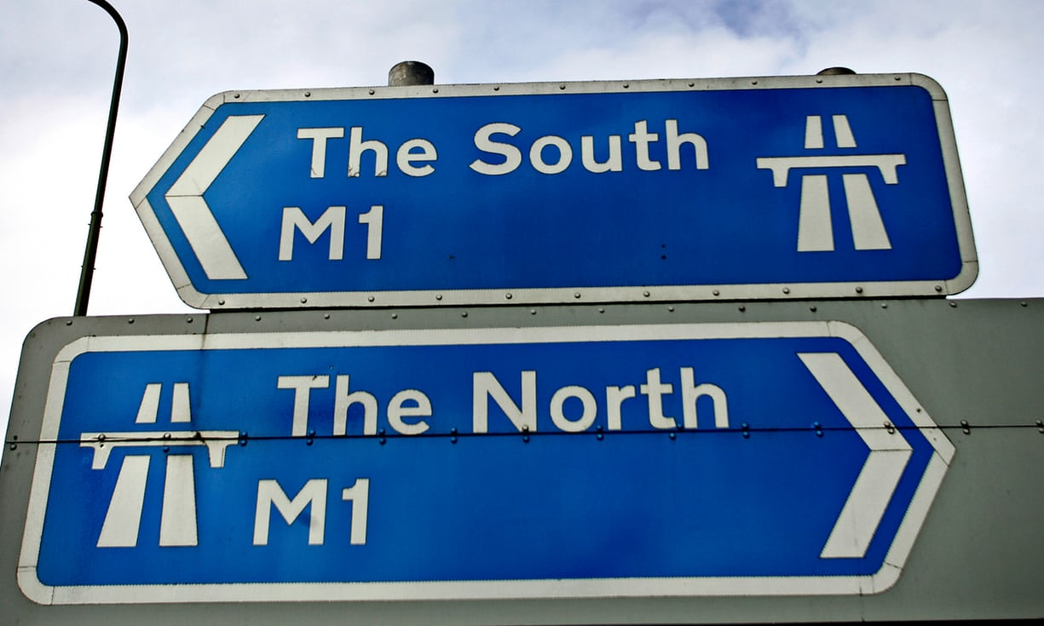
Part 3: The North – South Divide in England
M. Bourdeau UJML3 2020-2021

Slide 3
Contents
1. Historical & Geographical Data
2. Socio-Economic Differences
3. Is the North-South Divide a Myth?
4. Political Implications
5. The Legacy of Thatcherism
M. Bourdeau UJML3 2020-2021

Slide 4
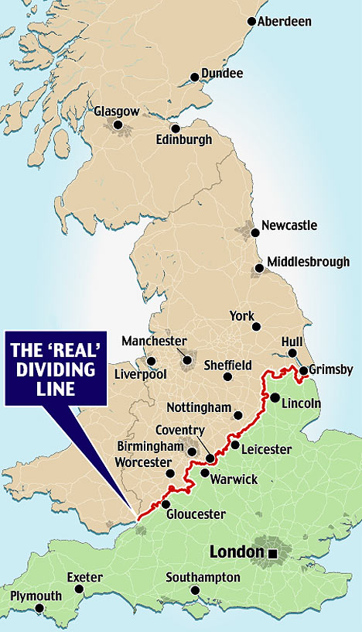
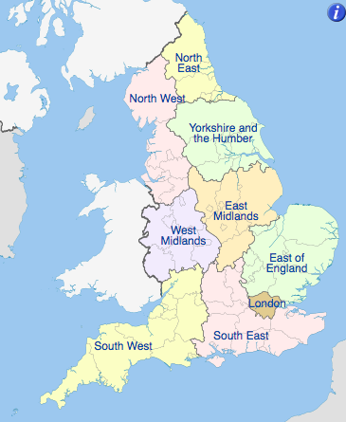
North and South?
M. Bourdeau UJML3 2020-2021

Slide 5




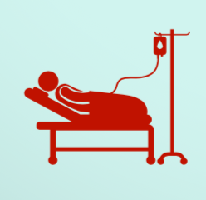
Affluent South VS less affluent North
M. Bourdeau UJML3 2020-2021
Life expectancy
Average
income
Access to
employment
Access to
elite universities
Long-term
illness

Slide 6
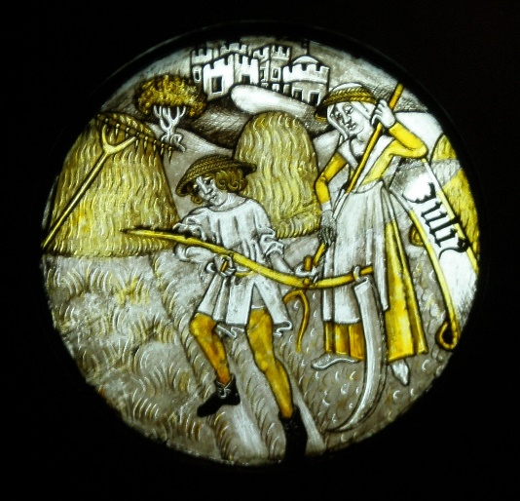
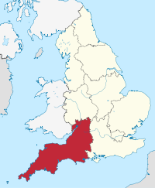
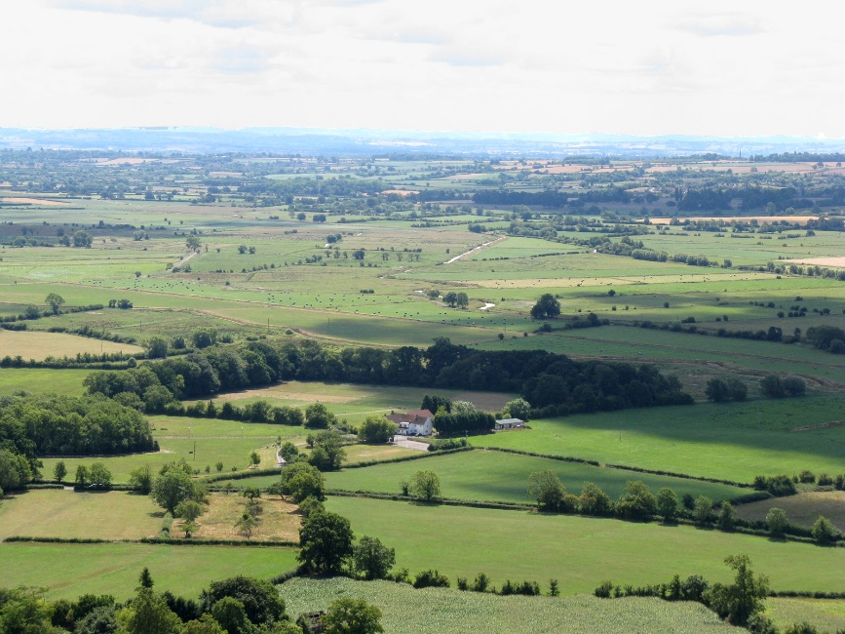
1. Historical & Geographical Data
Uneven regional development
Middle ages: agriculture in the South vs North = less developed & less peopled.
Northern reputation = rough
M. Bourdeau UJML3 2020-2021

Slide 7
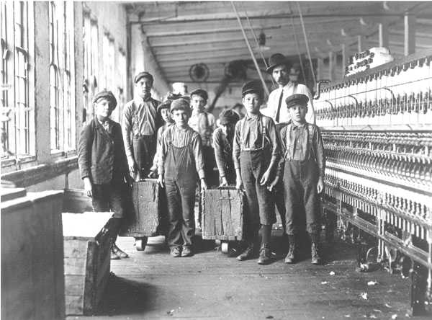
Develoment boost in the North <- Industrial Revolution
Cotton factories
M. Bourdeau UJML3 2020-2021

Slide 8
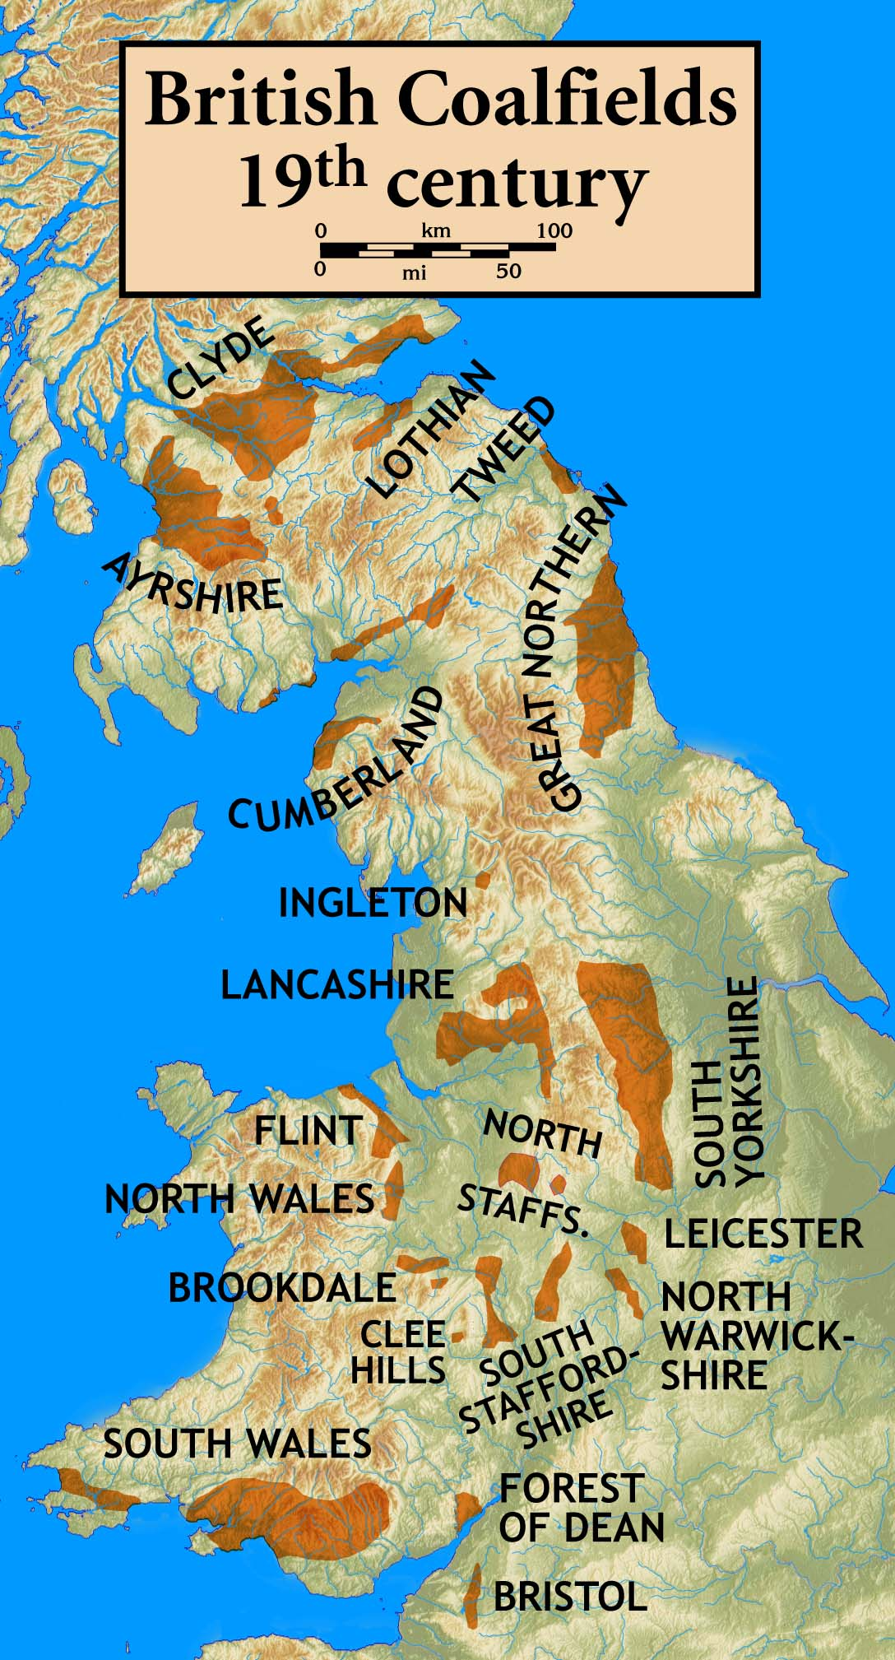
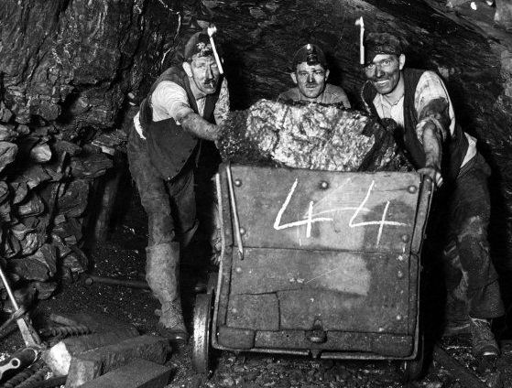
Coal mines
Main source for energy
Peak 1913 = 287 million tons
M. Bourdeau UJML3 2020-2021

Slide 9
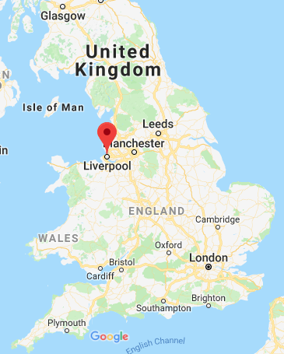
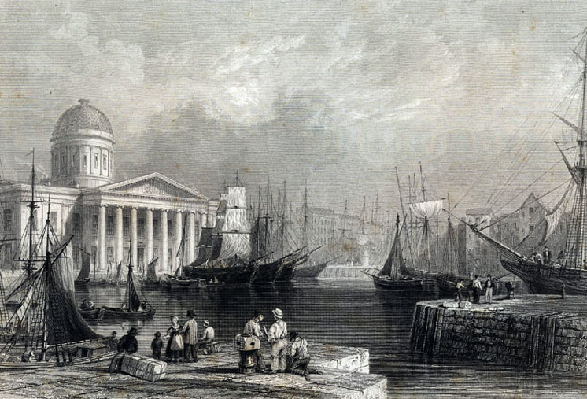
Liverpool = expanding port.
M. Bourdeau UJML3 2020-2021

Slide 10
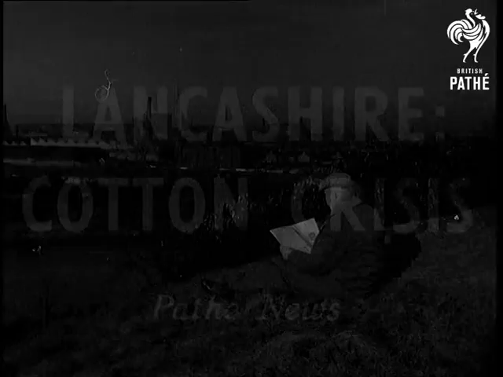
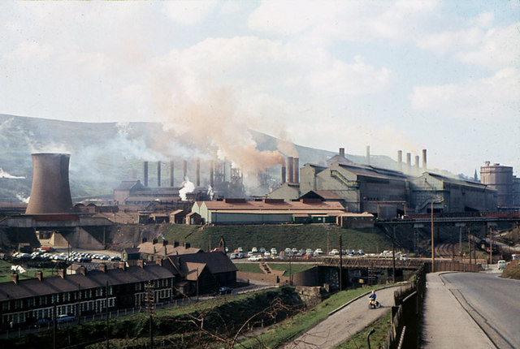
Post WWI = decline
From 1930 onwards= economic recession.
WWI- early 1960s:
British coal and steel : crisis
pop in the North = 35 % => 30 %.
Exacerbated N/S gap
M. Bourdeau UJML3 2020-2021

Slide 11
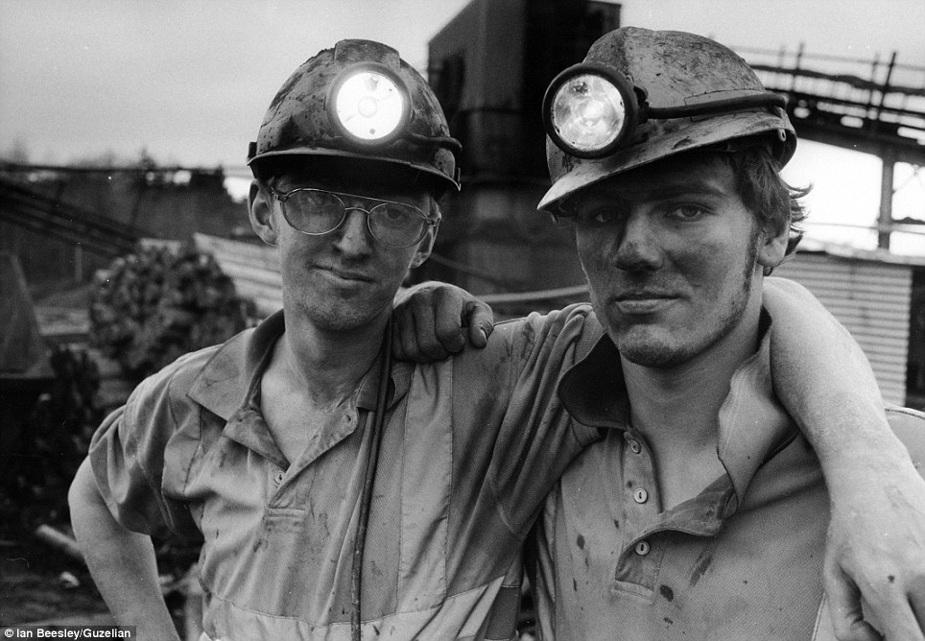
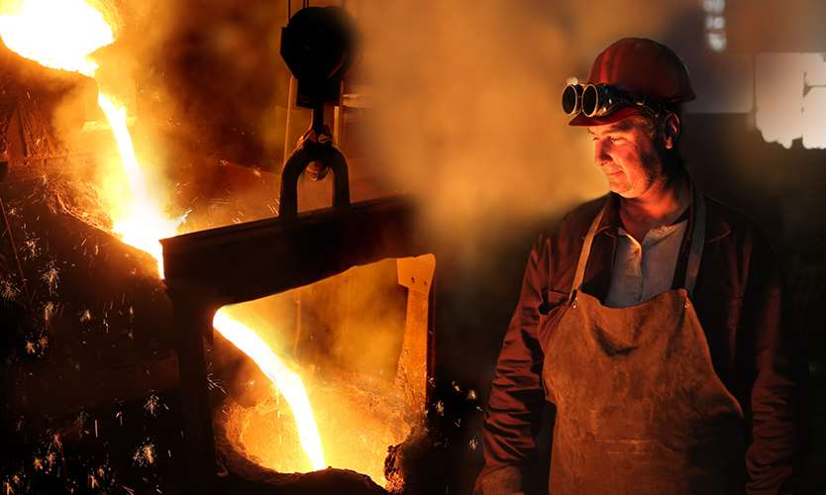

Division exacerbated by the restructuring of the British/English economy
From manufacturing to services: London & South = big winners vs North = not so much
Restructuring meant:
less investment in manufacturing
Fewer jobs
Growing unemployment
Still the case today.
M. Bourdeau UJML3 2020-2021

Slide 12
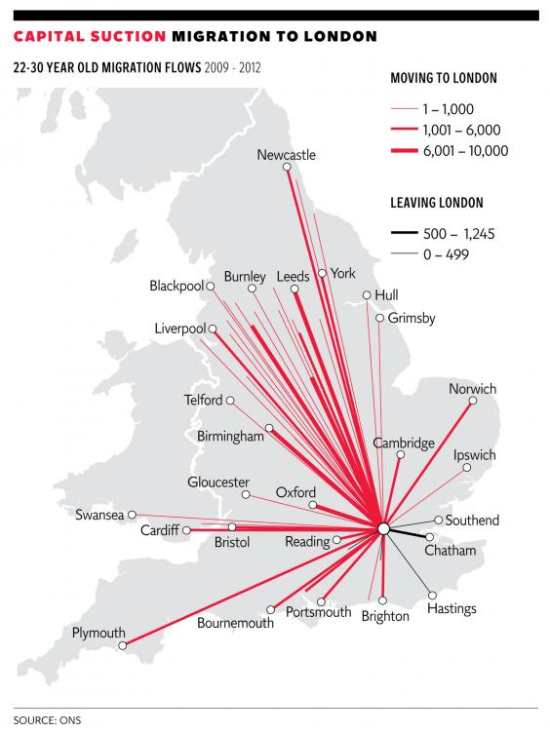
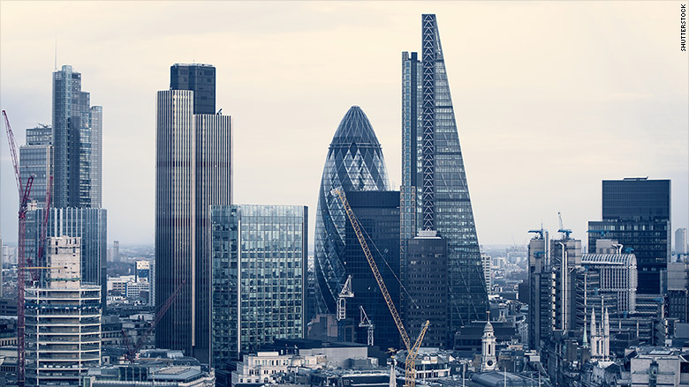
"London effect":
power of attraction
M. Bourdeau UJML3 2020-2021

Slide 13
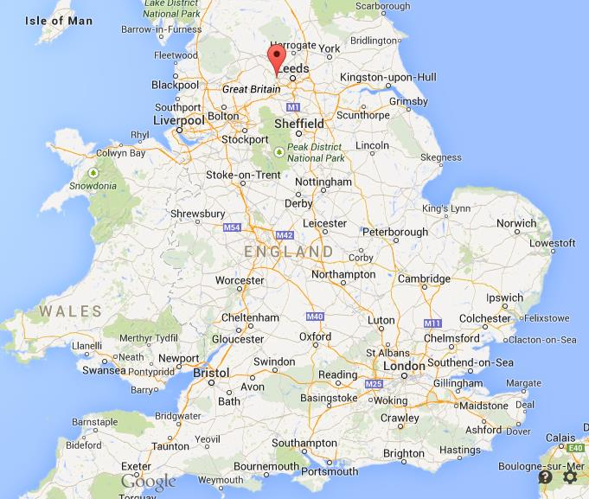
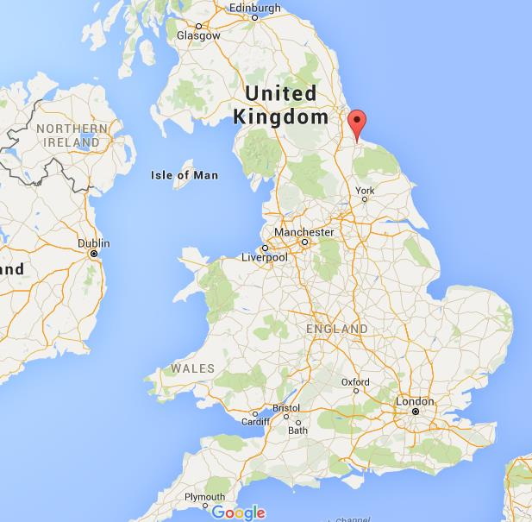
2. Socio-Economic Differences
North VS South
lower employment rates
lower average incomes.
Ex industrial cities hit particularly hard by unemployment
Bradford (Yorkshire and the Humber)
Middlesbrough (North East)
M. Bourdeau UJML3 2020-2021

Slide 14
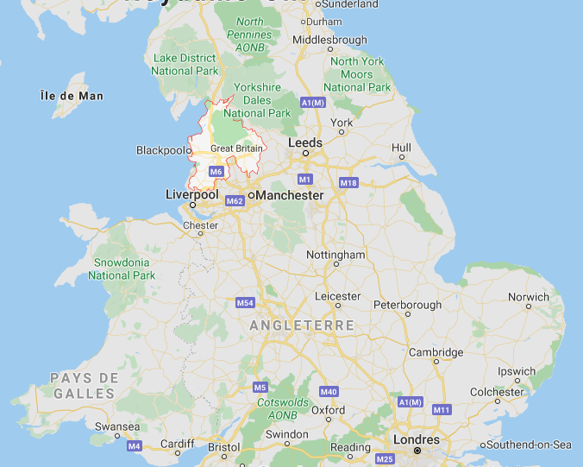
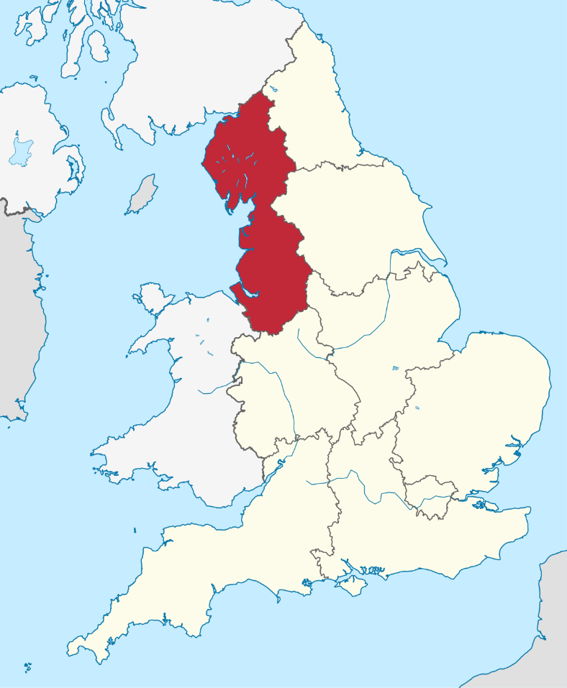
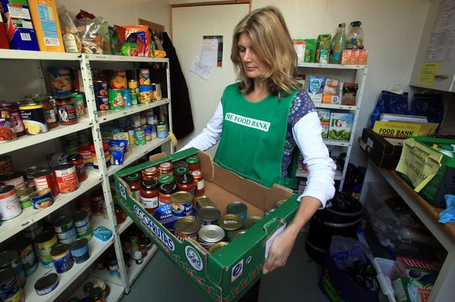
Unemployment => rapidly rising demand for social services
BUT North East and North West regions were imposed budget cuts (12%, VS 4.6% for the South East)
= inequalities & poverty made worse
9/10 of the poorest areas in England = in the North West Region.
M. Bourdeau UJML3 2020-2021

Slide 15
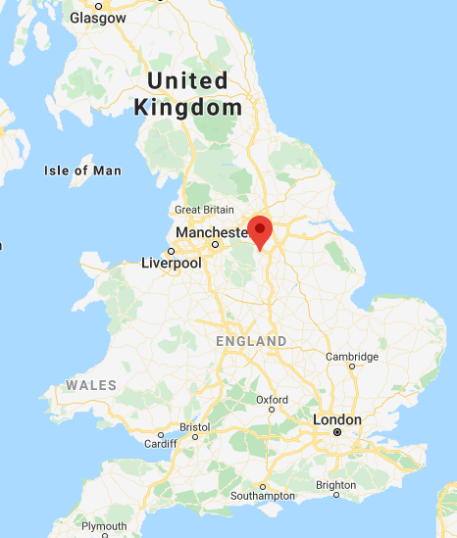
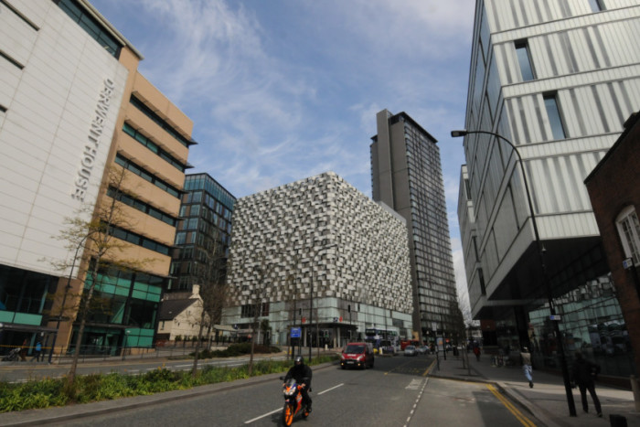
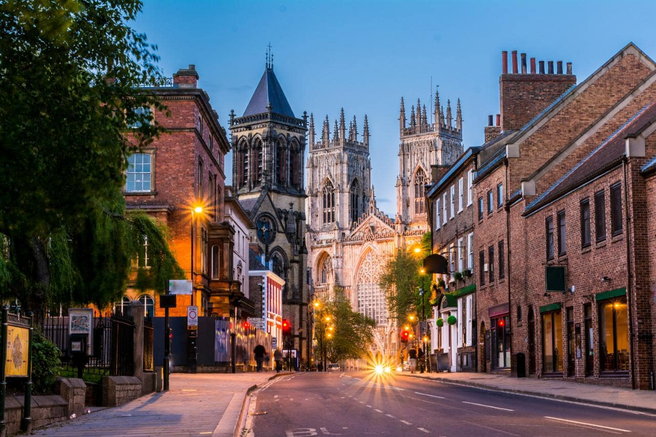
3. Is the North-South Divide a Myth?
‘Islands of affluence in a sea of poverty’. Examples:
Ex: Sheffield – Hallam (South Yorkshire)
Lowest level of child poverty in the UK
Wealthy constituency
M. Bourdeau UJML3 2020-2021

Slide 16
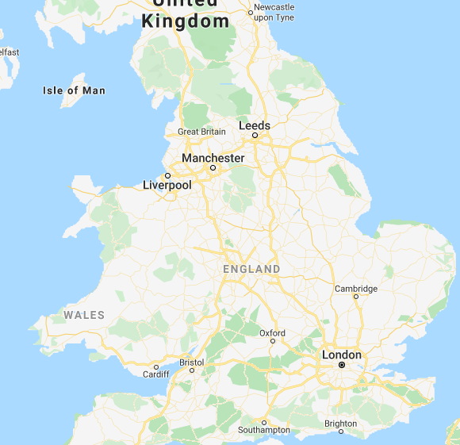
Some politicians = decline progressively erased?
Northern cities
More entrepeneurs?
Brand new universities
Revitalizing of business
Manchester and Leeds
Yuppies (Young Urban Professionals)
Regenerated city centres
M. Bourdeau UJML3 2020-2021

Slide 17
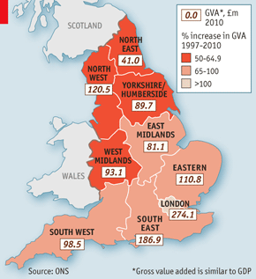
London and the south-east = Still top for education, income, employment and health.
North-east = still bottom for jobs, household disposable income and broadband access.
1997 – 2010= economic growth still mainly in the South (+90% vs. +60%)
GVA (Gross Value Added)
M. Bourdeau UJML3 2020-2021
Notes:
Valeur ajoutée brute = good and services produced minus the cost of production; a measure of output similar to GDP.

Slide 18
‘Islands of poverty in a sea of wealth’?
London
one in four children live in overcrowded homes.
7 out of the 20 English local authorities with the highest levels of child poverty are in London
Housing crisis: 25% of Londoners with housing benefits to pay rent.
Inequality = not just a North/South matter.
M. Bourdeau UJML3 2020-2021

Slide 19
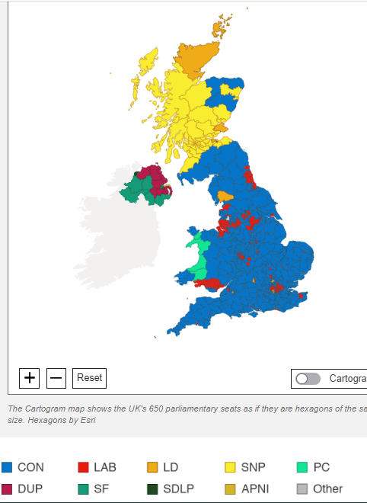
4. Political Implications
Problem of image for both parties:
Conservative: party of one class (the rich)?
Labour: party of one region (the North) (+ London) ?
Conservative Party
Gained ground in the North in the 2019 election.
Still, remains mostly invisible in cities and in former coal-mining areas
M. Bourdeau UJML3 2020-2021

Slide 20
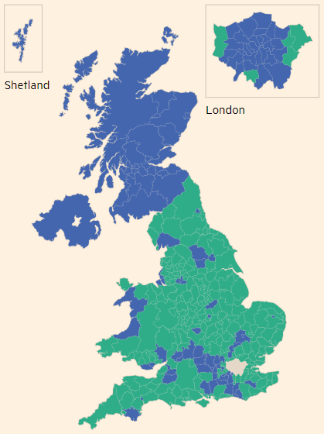
Brexit vote:
Large, cosmopolitan cities = Remain
vs.
Rural areas & postindustrial towns (little benefit from globalization) incl. many traditional Labour strongholds = Leave.
=> Brexit vote = not a partisan / regional vote
Source : The Financial Times
M. Bourdeau UJML3 2020-2021

Slide 21
Conclusion?
Economic and social divide
More of a rich/poor problem?
England’s nickname: ‘a class-ridden society’
M. Bourdeau UJML3 2020-2021

Slide 22
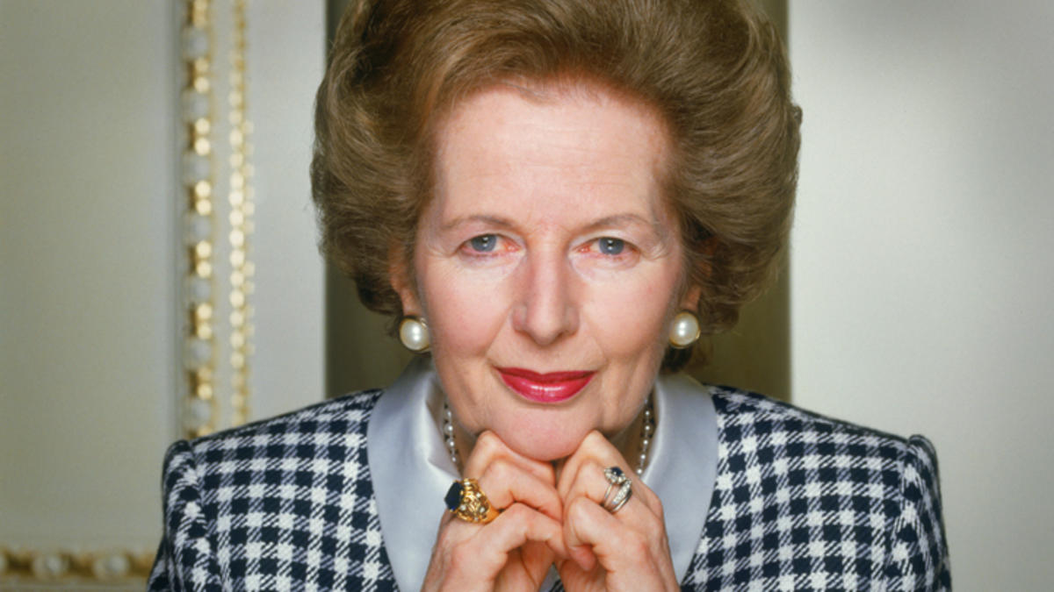
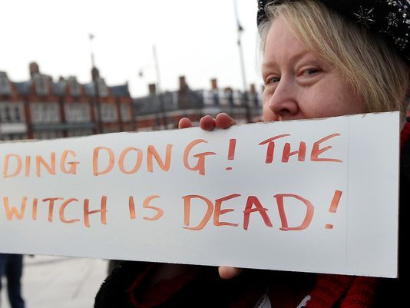
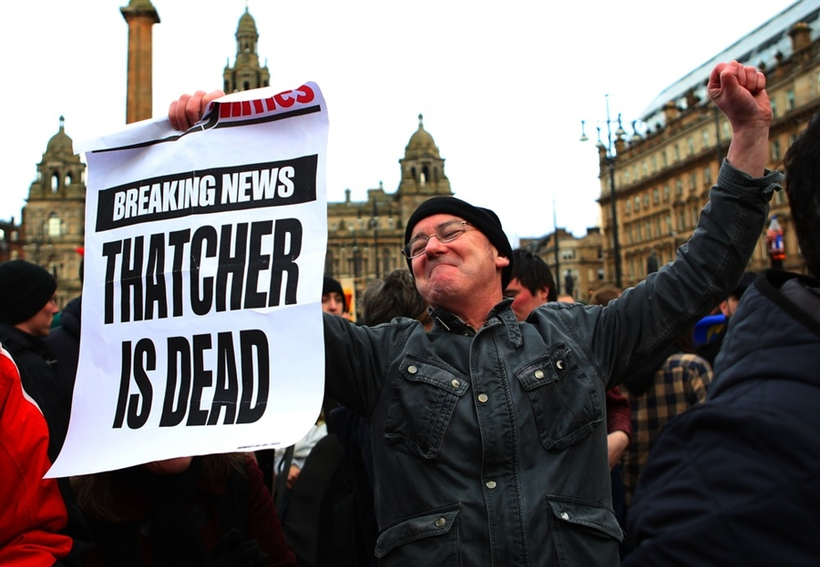
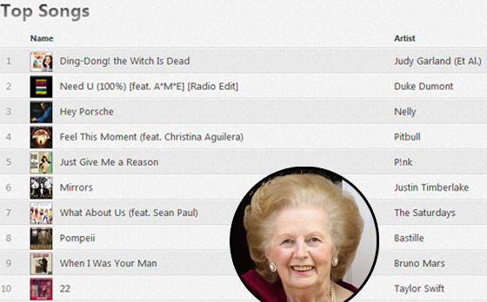
5. The Legacy of Thatcherism
Margaret Thatcher (PM: 1979-1990)
M. Bourdeau UJML3 2020-2021

Slide 23
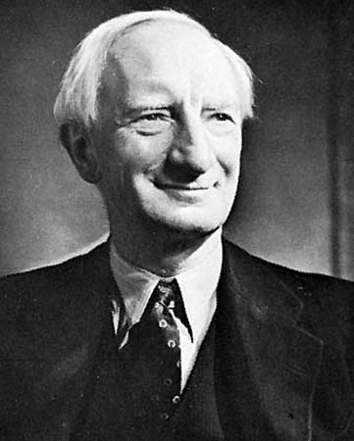
End of WW2: ”5 Giant Evils” to eradicate: Want, Disease, Ignorance, Squalor and Idleness.
=> Welfare State:
1945: Family Allowances Act
1946: National Insurance Act
1946: National Health Service (NHS)
« From the craddle to the grave »
Policies funded with taxes or contribution
Nationalisation of the economy
WWII-1970s: general consensus
M. Bourdeau UJML3 2020-2021
William Beveridge
The Beveridge Report (1942)

Slide 24
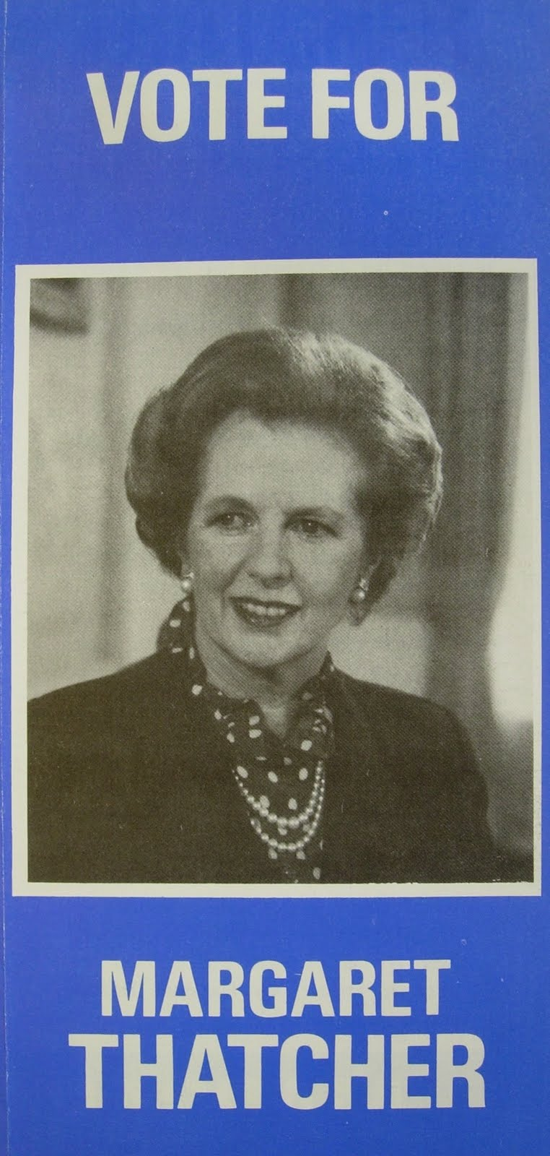
Early 1970s:
Economic and social changes => Britain as the ‘sick man of Europe’
Strikes
social unrest
economic stagnation
‘Winter of Discontent’ (1978-1979)
Thatcher = Promise of a radical alternative
M. Bourdeau UJML3 2020-2021
Notes:
PM at the Time = Callaghan (Labour)

Slide 25
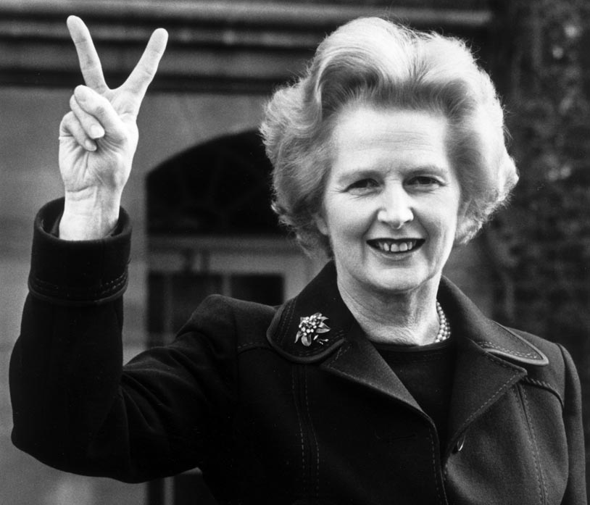
« Thatcherism » : goes against all the Welfare State stood for (ie social and societal solidarity)
Low taxation
Small government
Deregulation
Privatisation
Reduced trade union power
Individualism
From state regulation to free market
Implemented the ‘trickle-down economy’ => benefitting the wealthy only
M. Bourdeau UJML3 2020-2021
« There's no such thing as society.
There are individual men and women and there are families. And no government can do anything except through people, and people must look after themselves first. »

Slide 26
Thatcherism = Economic growth but no social gains.
Social unrest: early 1980s=
Loss of manufacturing jobs => increase in service jobs
Closing down of the coalmines (North)
1984-85 miners’ strike (142,000 strikers)
Strike declared illegal => police use
Trade unions designated as the ‘Enemy within’
Refusal to negotiate with the trade unions => major loss of TU influence => dire structural and human consequences
Increased class division and hostility, still noticeable today
M. Bourdeau UJML3 2020-2021

Slide 27
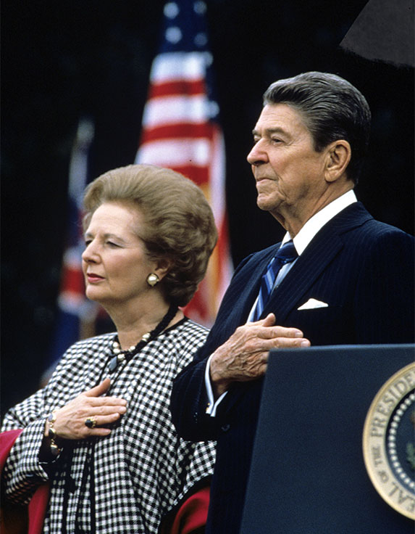
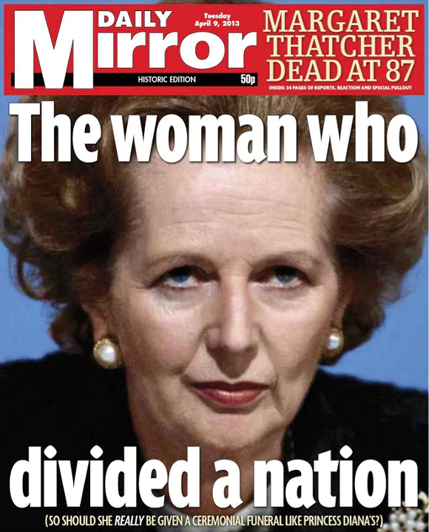
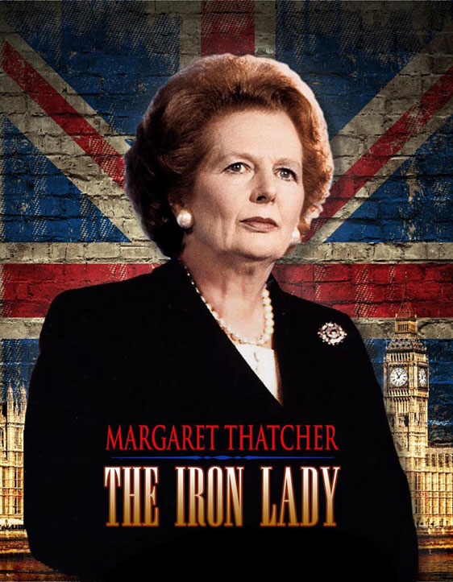
"Iron Lady".
World politics: British leadership in the world restaured?
Falkland Islands war
‘Special Relationship’ with Reagan
Home politics: highly controversial legacy (Ireland, society, economics)
M. Bourdeau UJML3 2020-2021

